Slide 1
Compare two things in sena
For:
Jacob Rivas LEmos

Slide 2
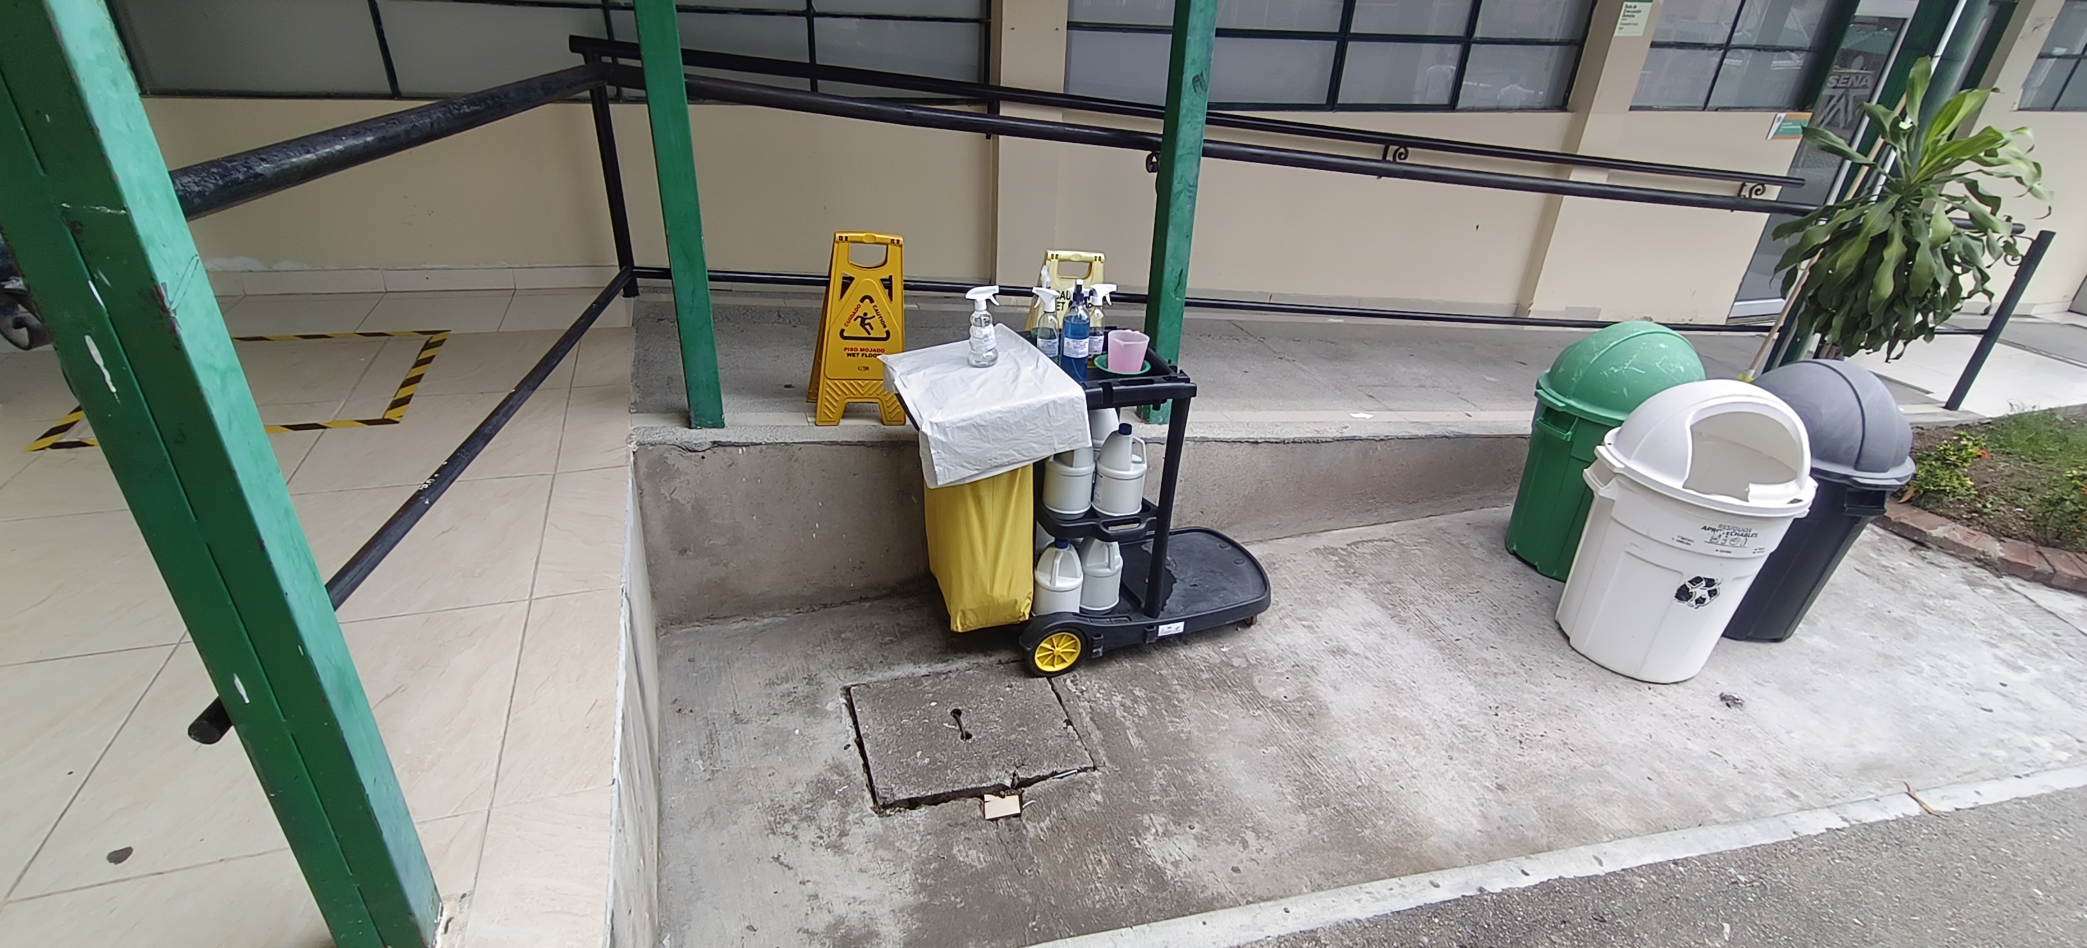
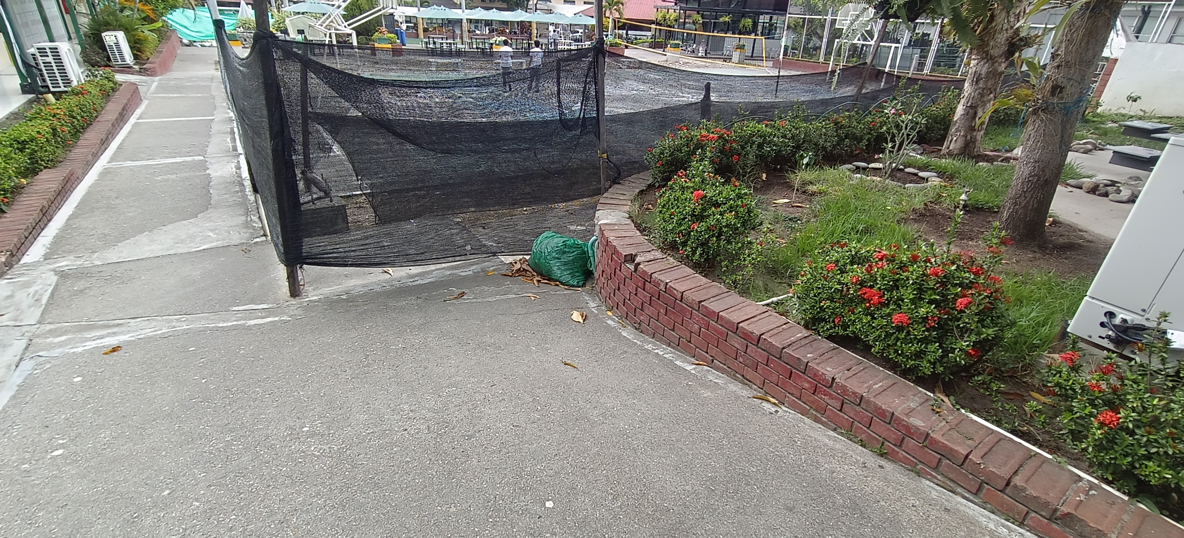
The cleaning cart is cleaner than the trash bag.
1.CLEAN

Slide 3
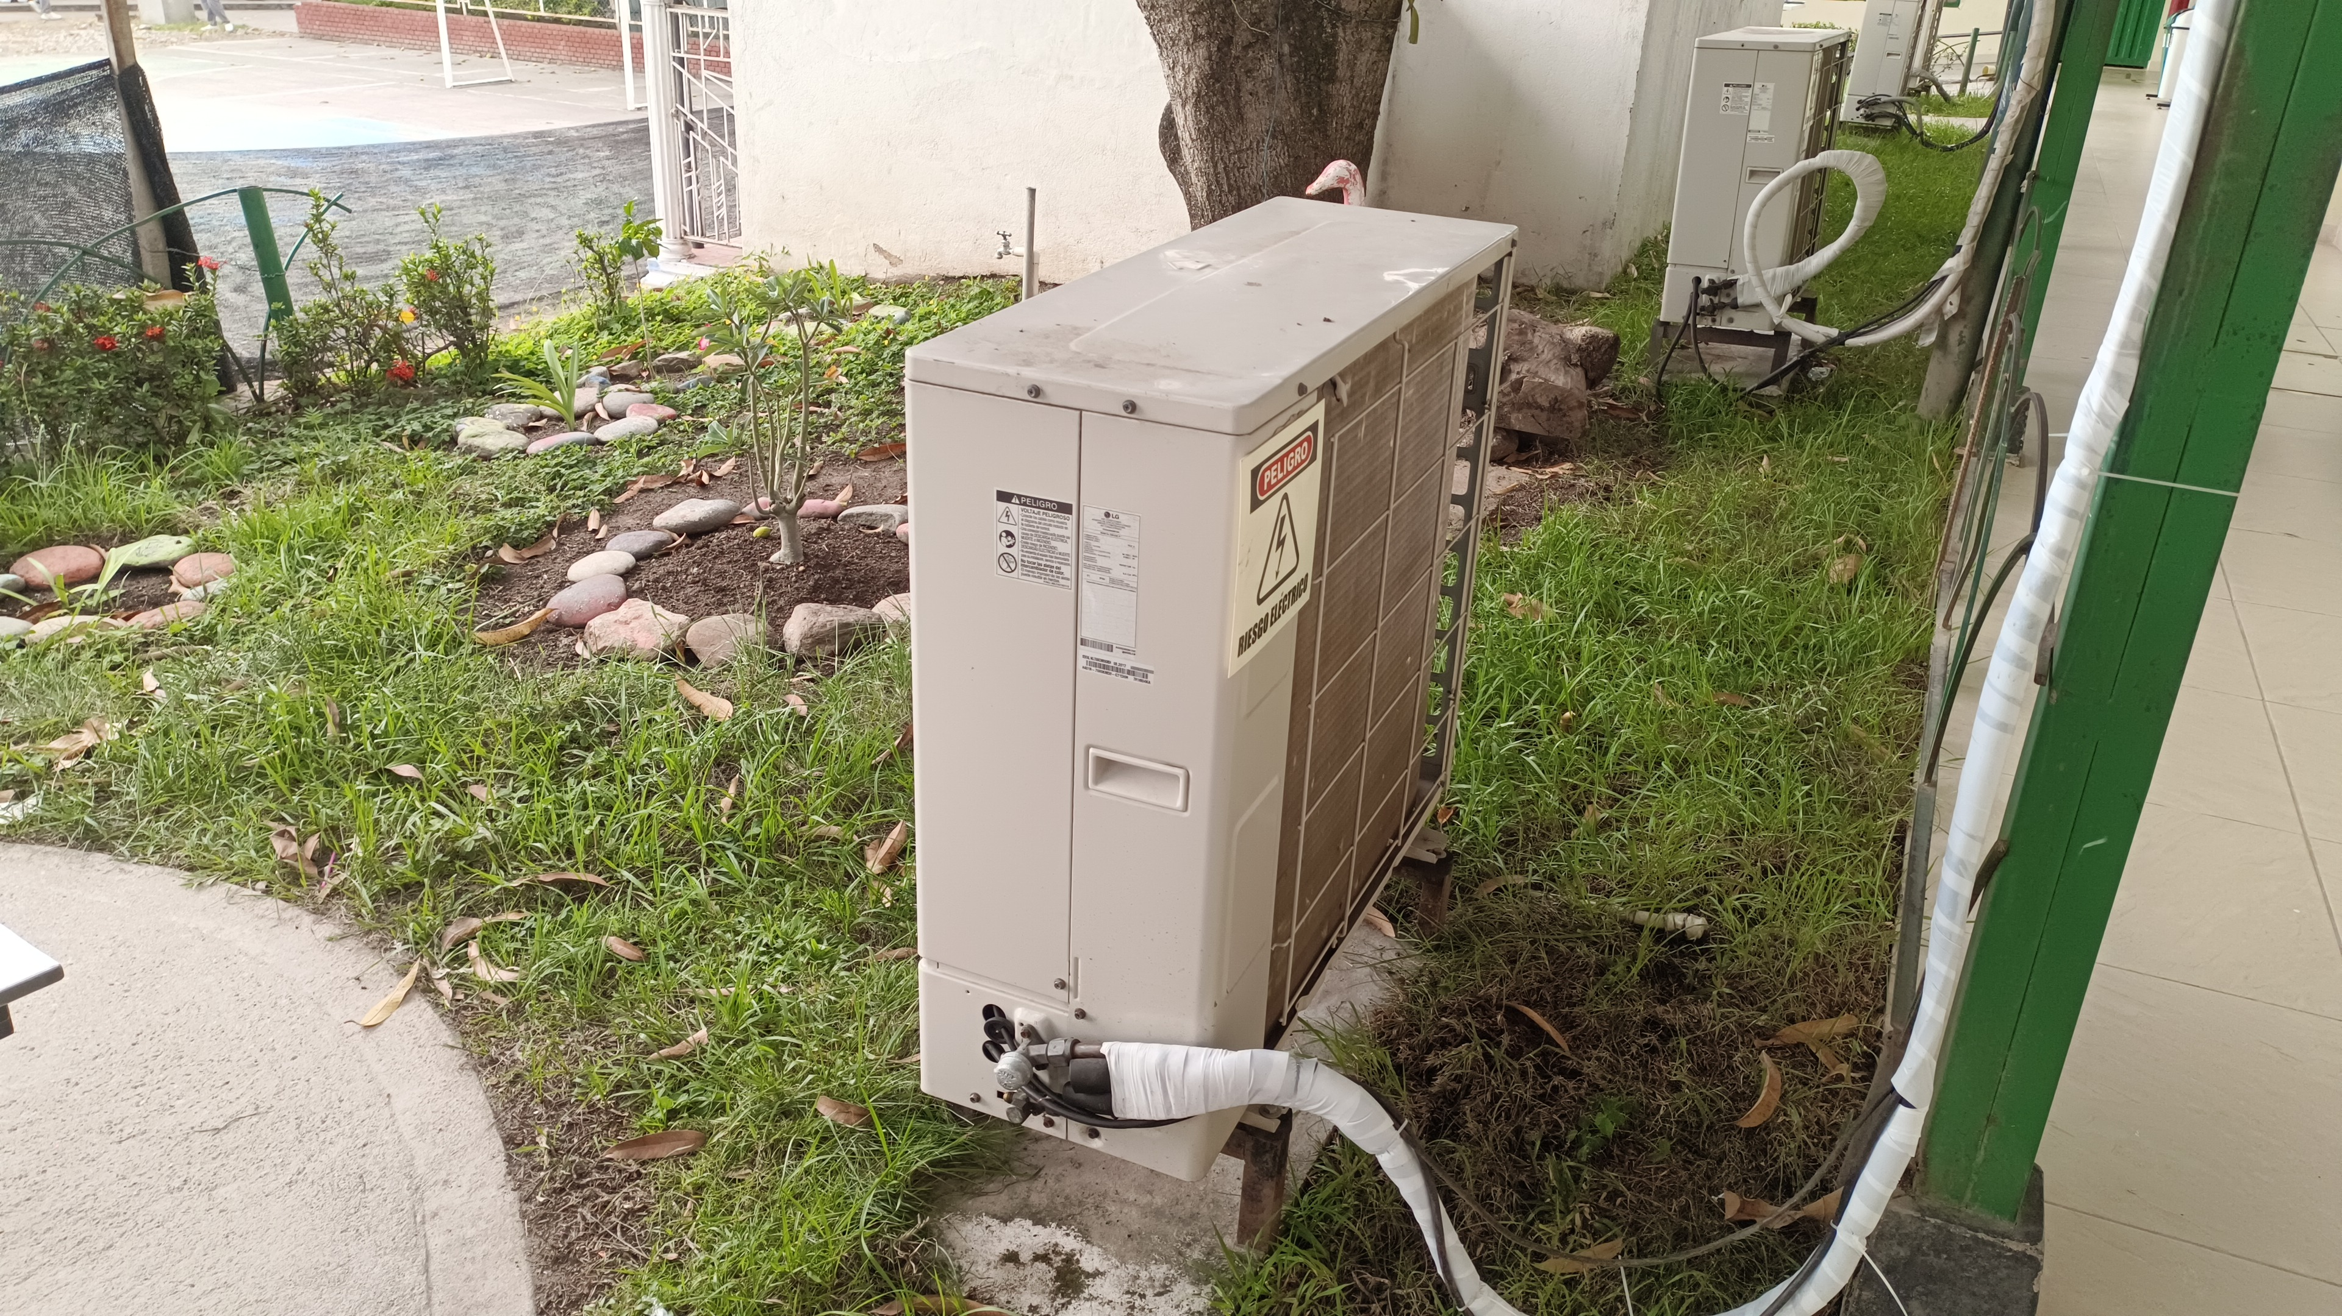
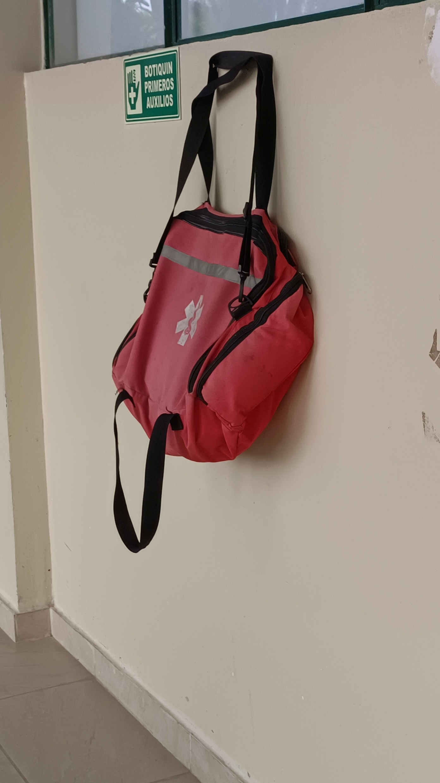
The backpack is bigger than the air conditioner.
1.BIG

Slide 4
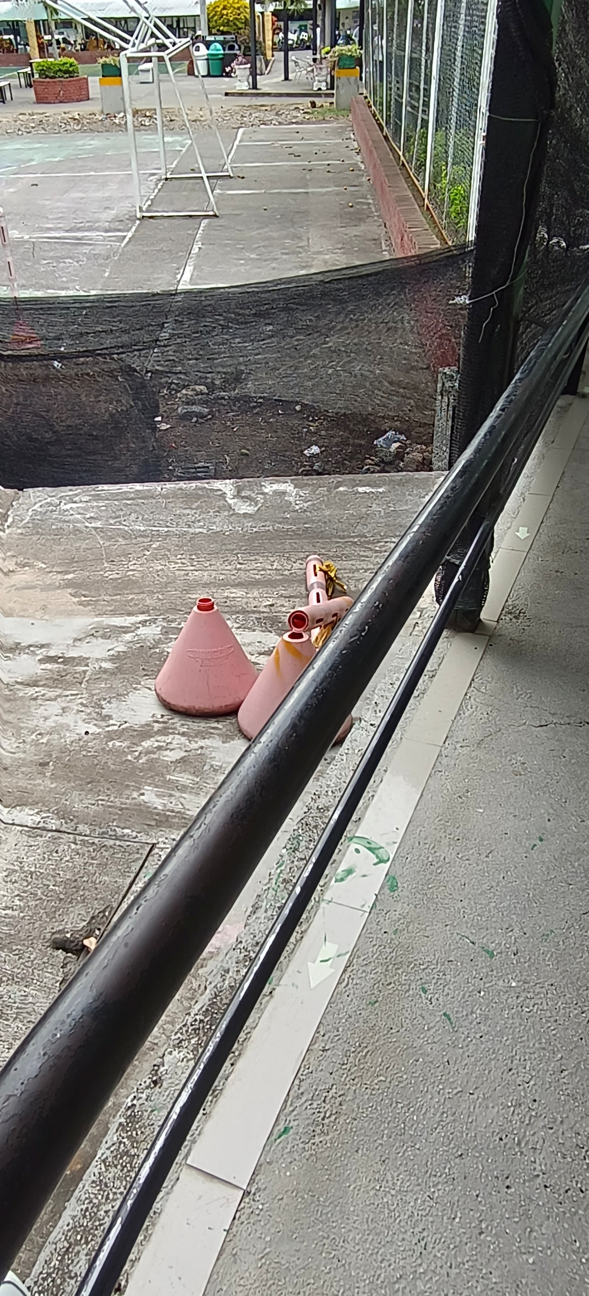
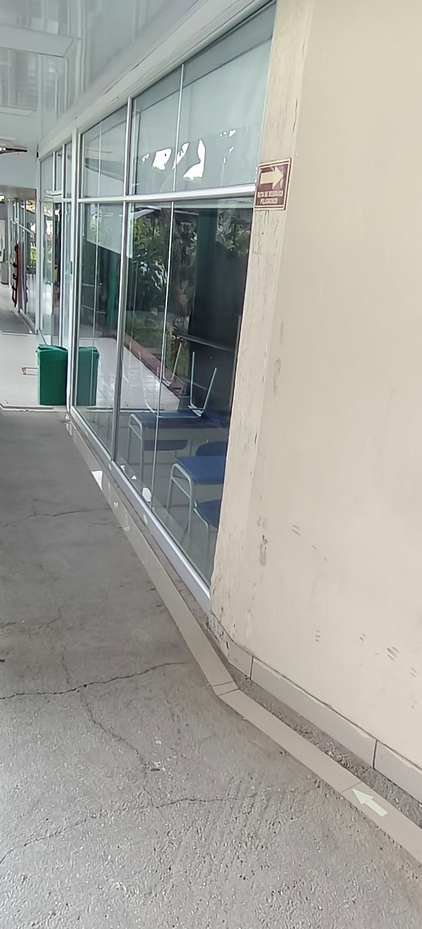
The balcony is more insecure than the properly secured glass.
3.INSECURE

Slide 5
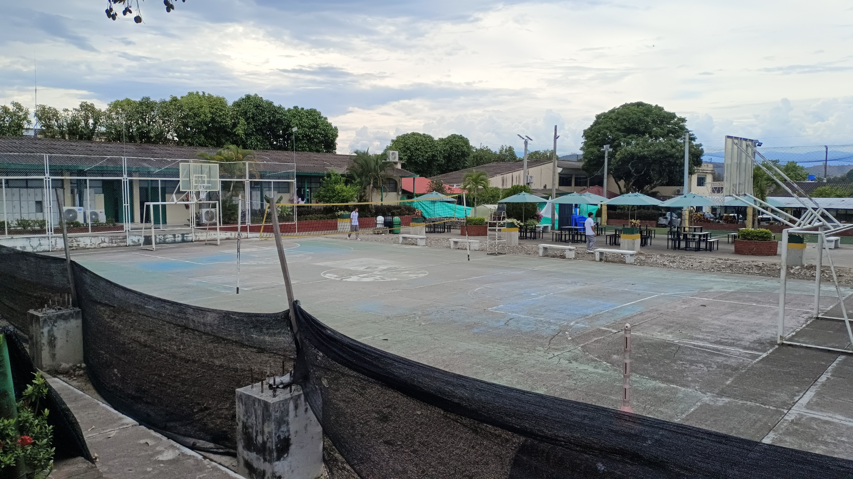
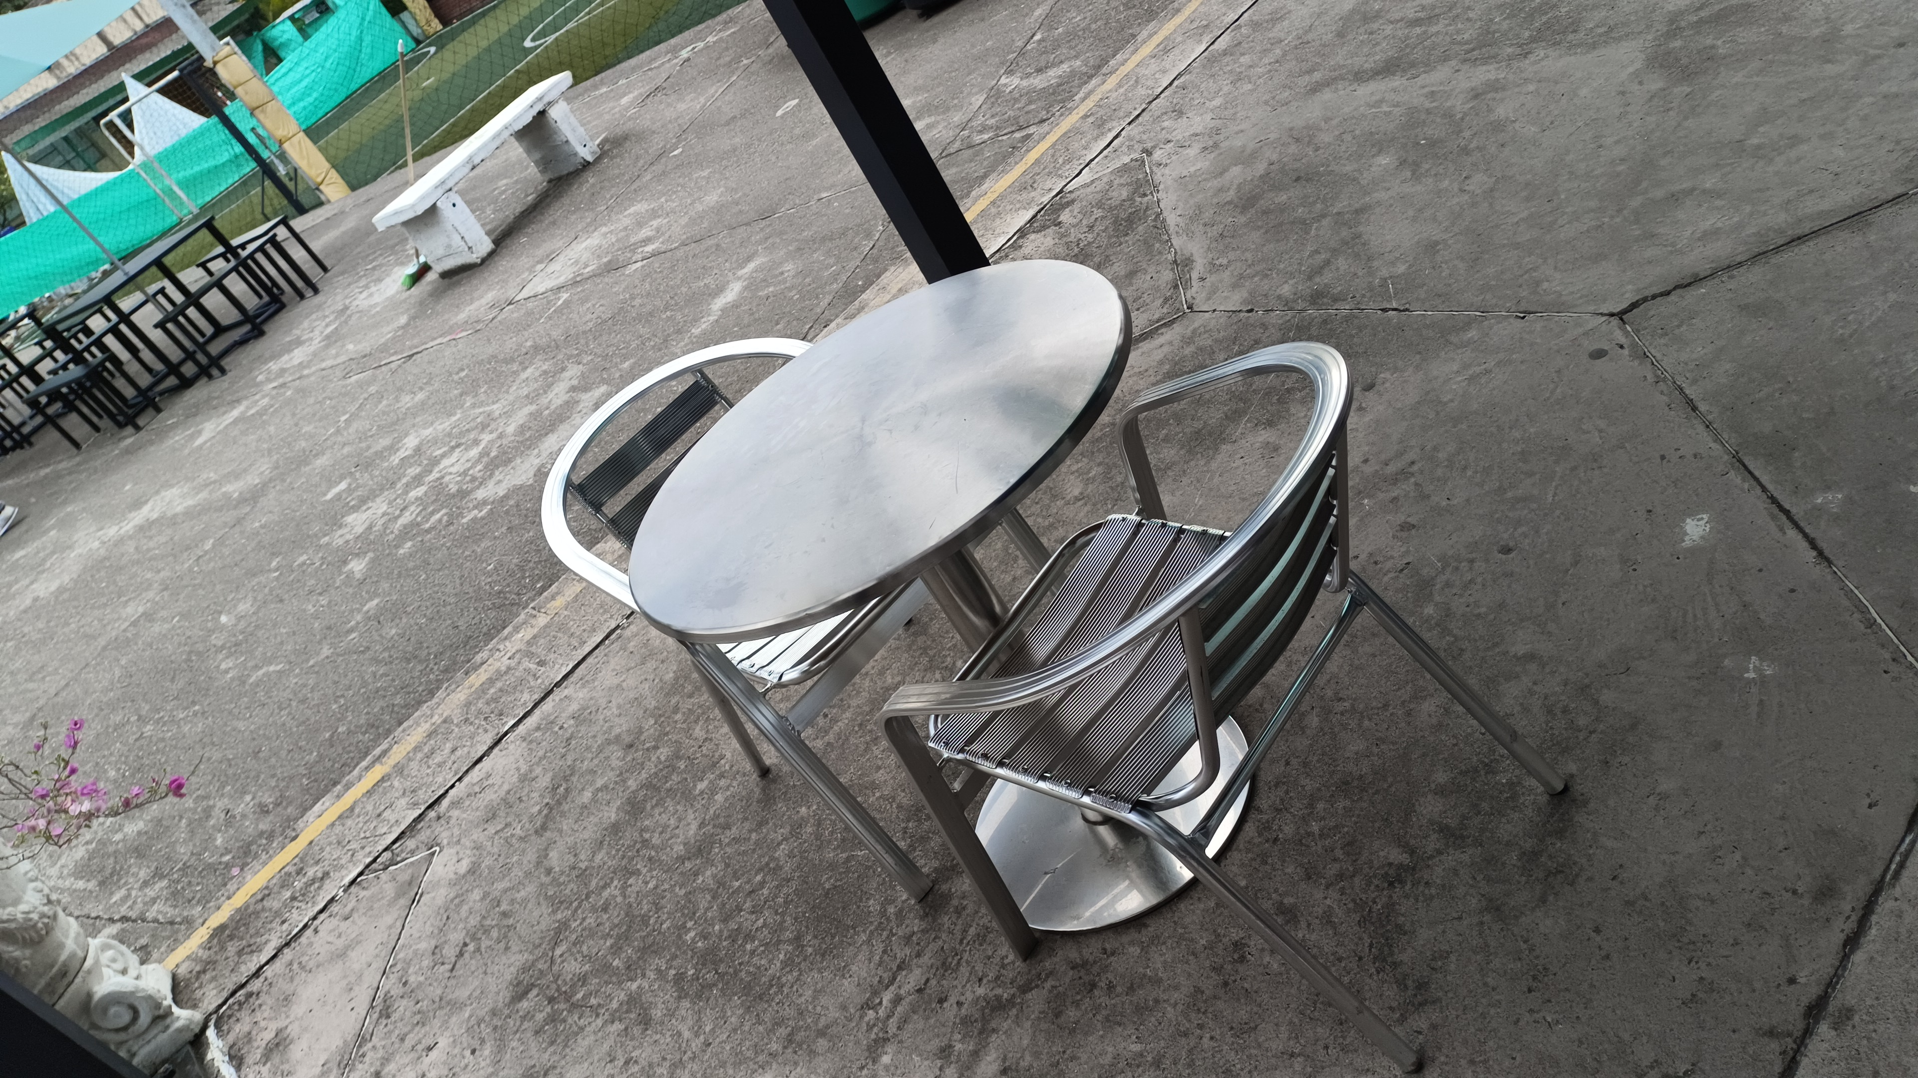
The sports court is funnier than the sitting table
4.FUN

Slide 6
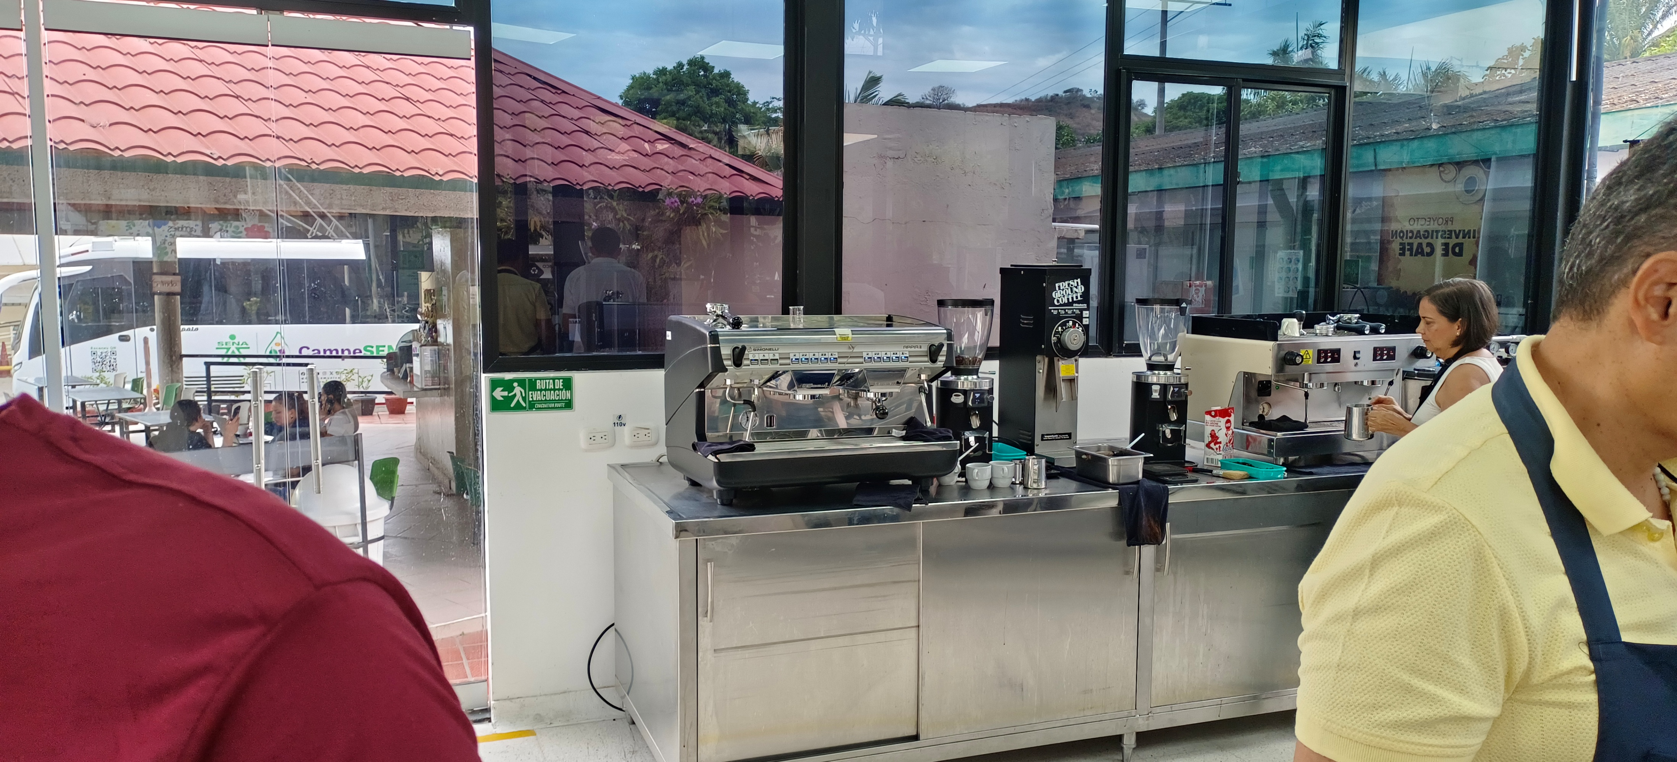
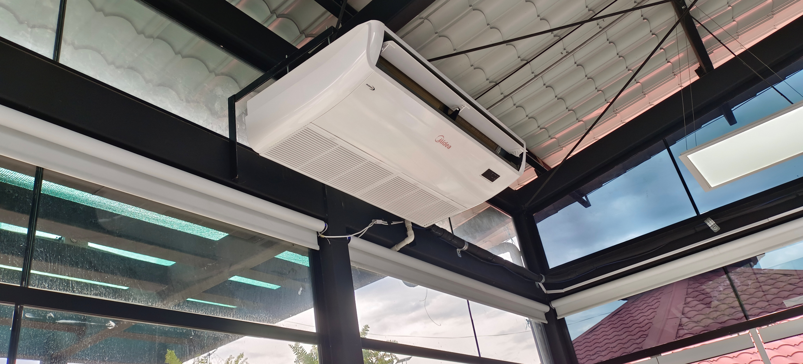
The coffee machine is more modern than the air conditioner
5.MODERN

Slide 7
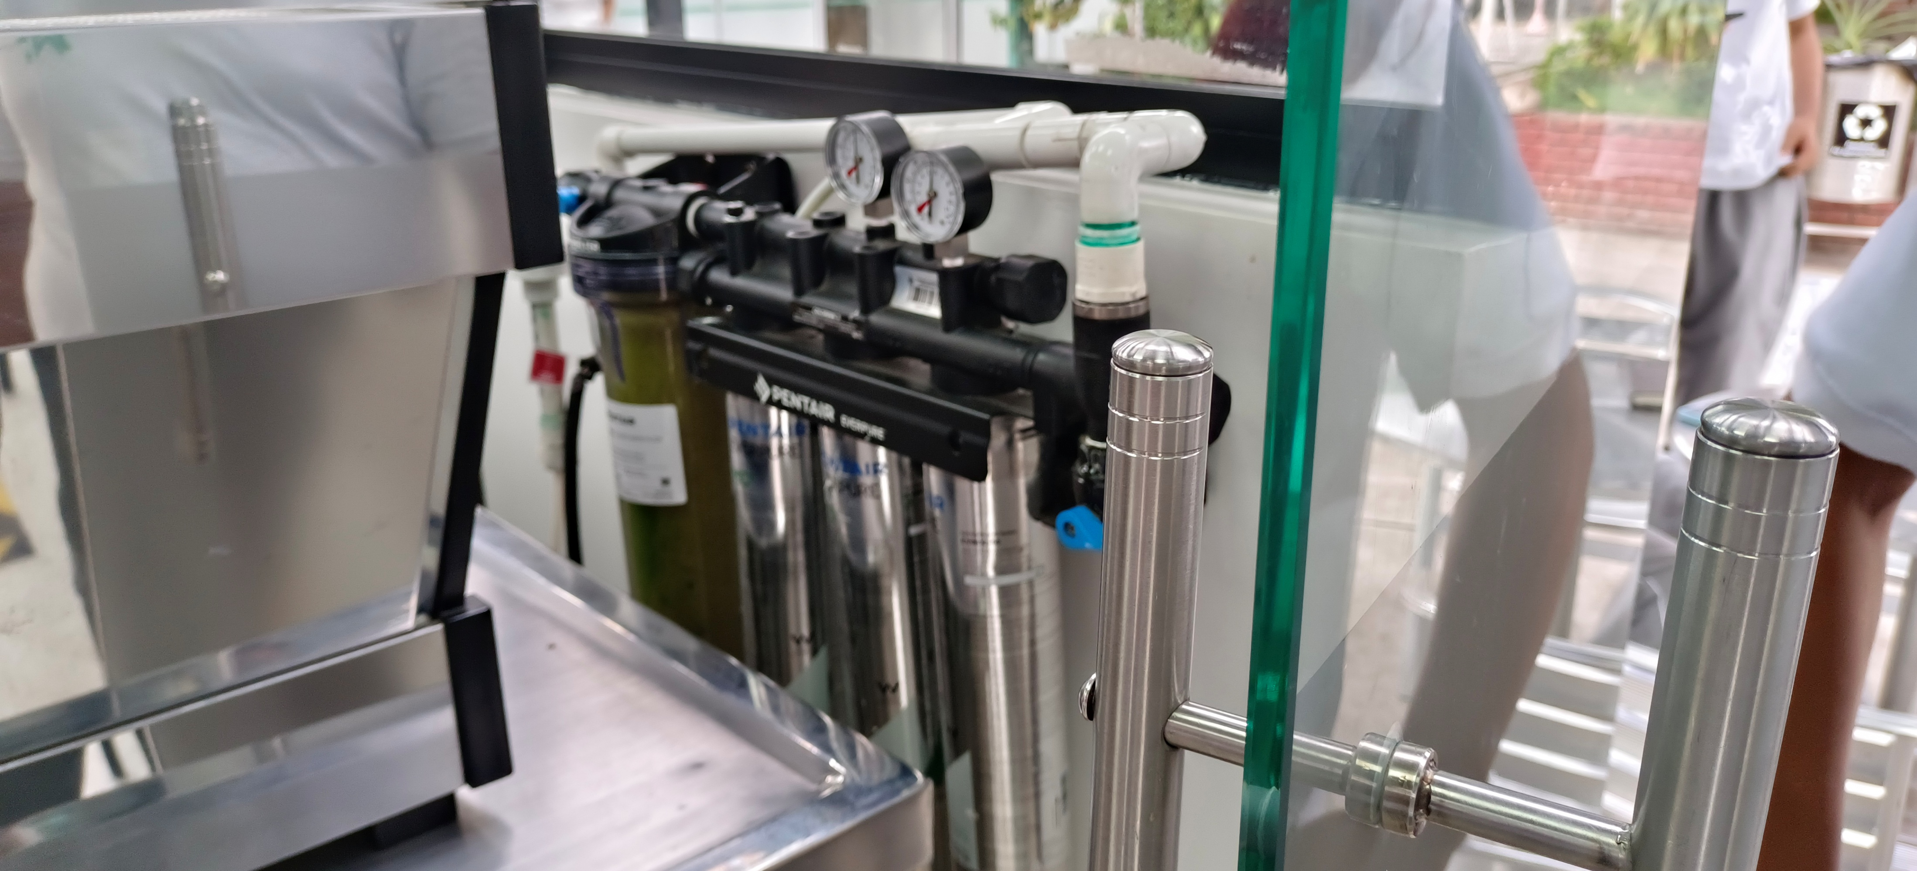
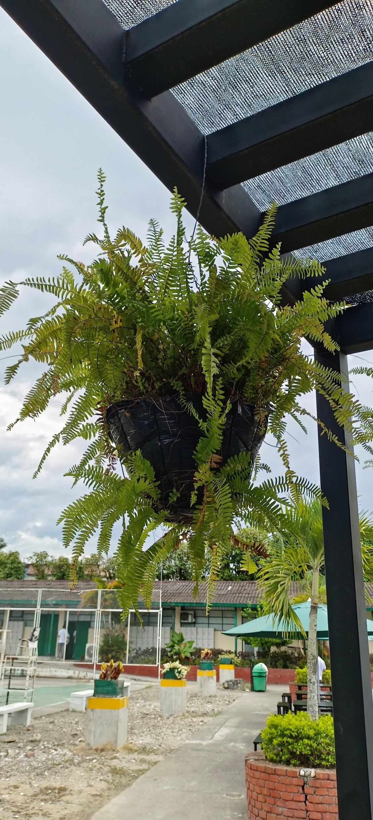
The coffee compression tank is more dangerous than the hanging plant
6.DANGEROUS

